Slide 1

Triple G Logo

Slide 2
Location/Contact Information
5407 Oak Orchard Road
Elba, NY 14058
Phone: 585-589-4134
Fax: 585-589-1316
Email: Guy@triplegfarms.com

Slide 3
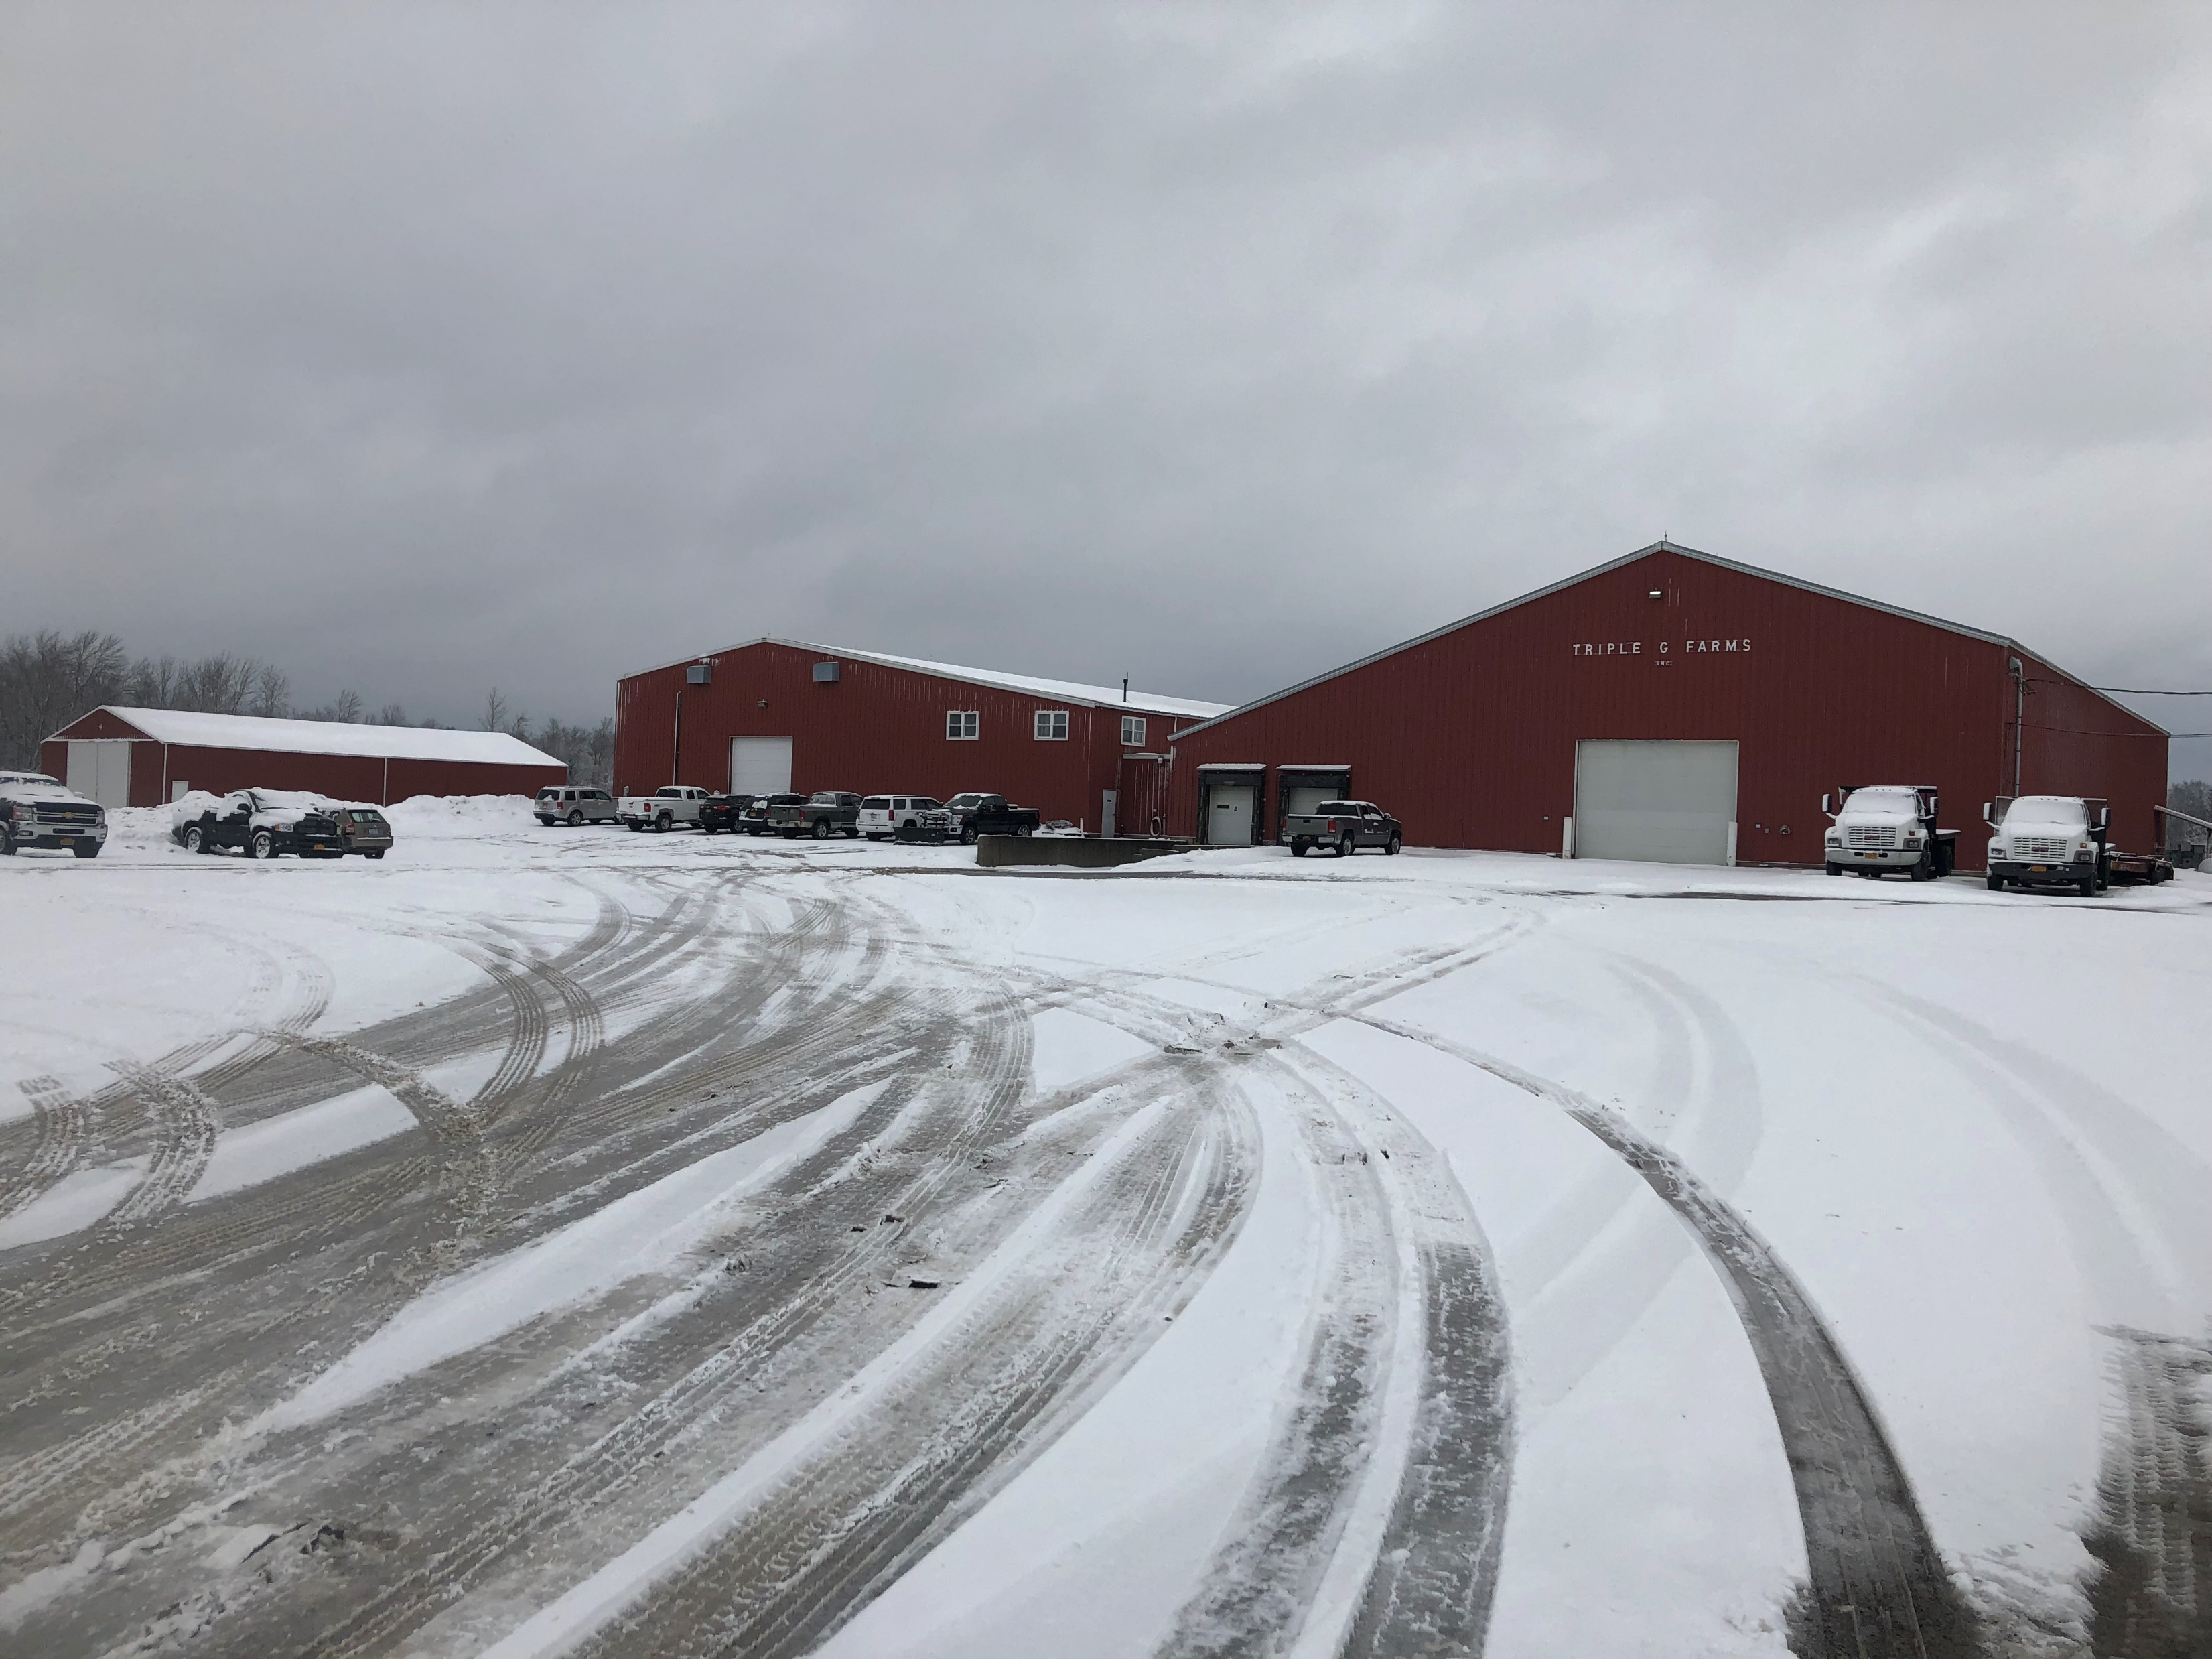

Slide 4
History
Founded in 1925 by Waldo Smith
Farming of Onions & Potatoes
Grown in the of Elba, NY the Onion Capital of the World
In 1932 Waldo his father (William) and brother (Marvin) purchased 35 acres of land to add to the farm.
In 1952 Waldo retired and his two sons Ernest Waldo and Clyde Alfred began farming under the name of Smith Brothers.

Slide 5
History Cont.
1981 Triple G Farms was founded
The 3 brothers Gary, Greg & Guy purchased the farm
The brothers would be the 4th generation of the Smith Family
Between 1984 – 1987 the Smith brothers added additional facilities for the growth of the business.
In 1987 Triple G Farms transitioned to computerized weighers and baggers.
In 1991 the brothers purchased another farm, warehouse and an additional 94 acres to grow their products.

Slide 6

History Cont.
In 1999 Triple G Brokerage, LLC was formed
We expanded the operation in 1999 to include trucking over the road to accommodate our customers.
2004 installed Onion Dryer to cure early onions at harvest.
2006 installed Potato storage cooler.
2007 Gary’s son (Peter) began working on the farm.
2008 installed computerized weigher.

Slide 7


Slide 8
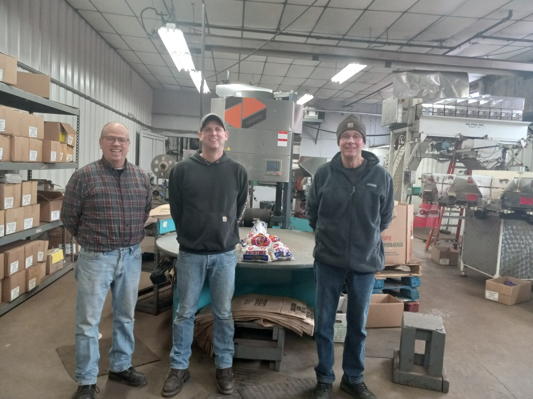
Meet the Owners
Left to Right
Guy Smith
Peter Smith
Greg Smith

Slide 9
History
2017 Gary Smith Retired and Peter Smith became Co-owner and the 5th generation to farm.
Since 1981 Triple G has doubled in acreage.
We have the state-of-the-art computerized packing equipment
This equipment allows us to customize our customer’s packing specifications.

Slide 10
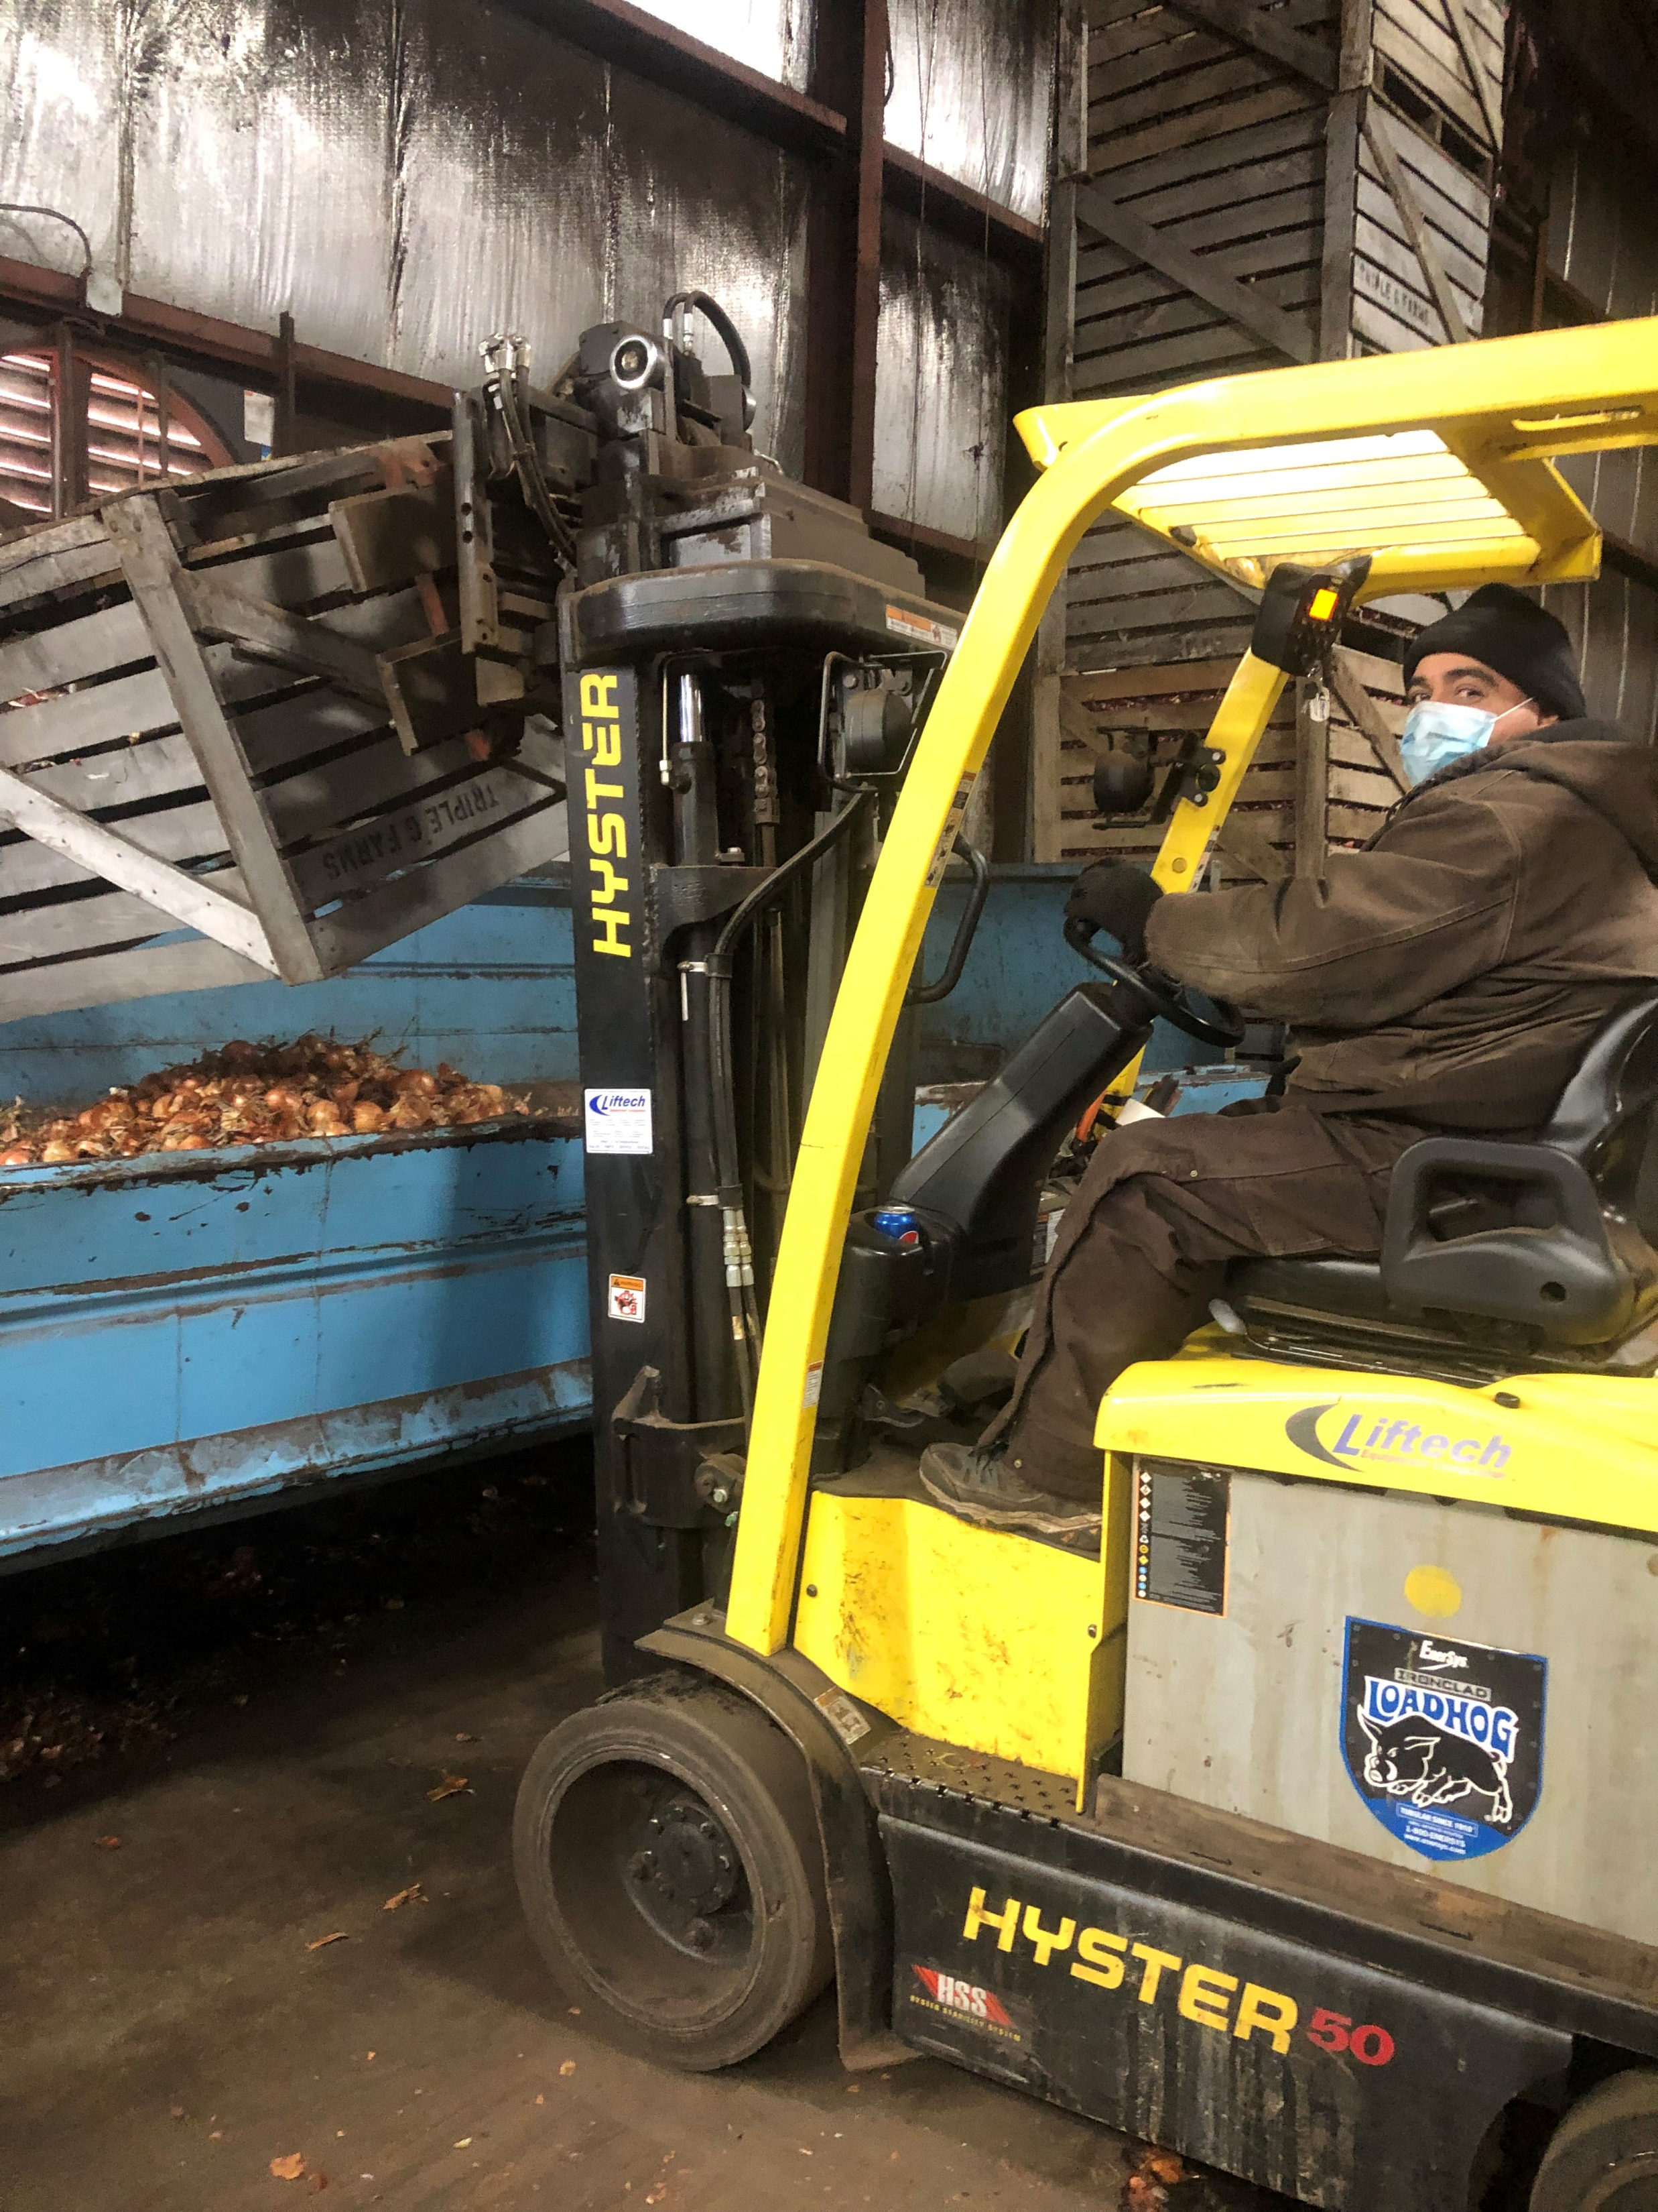

Slide 11
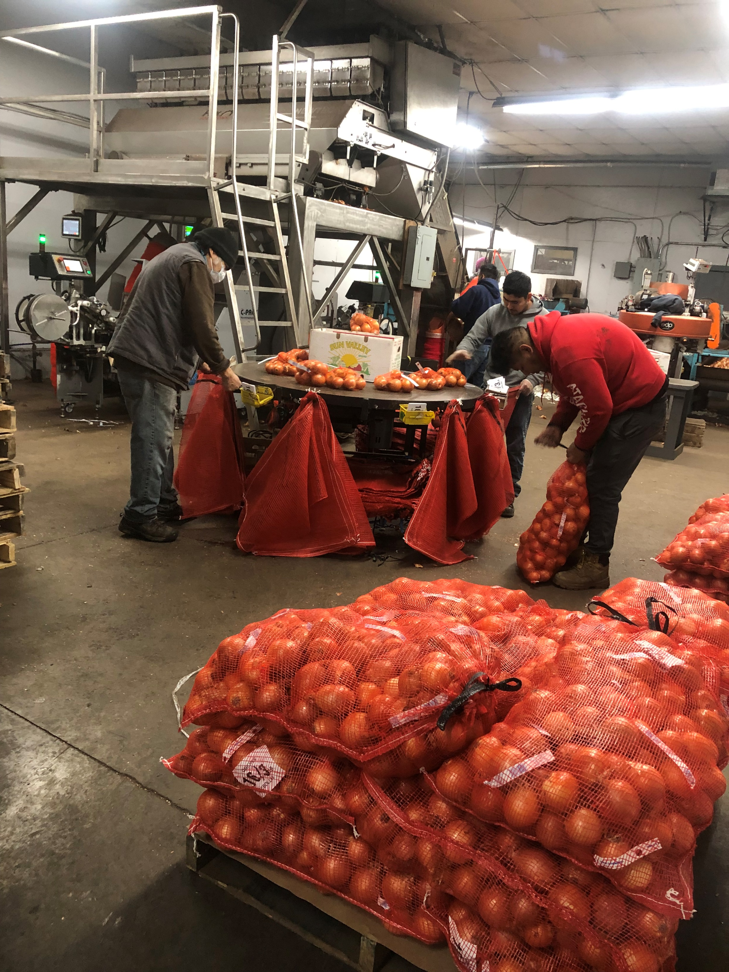
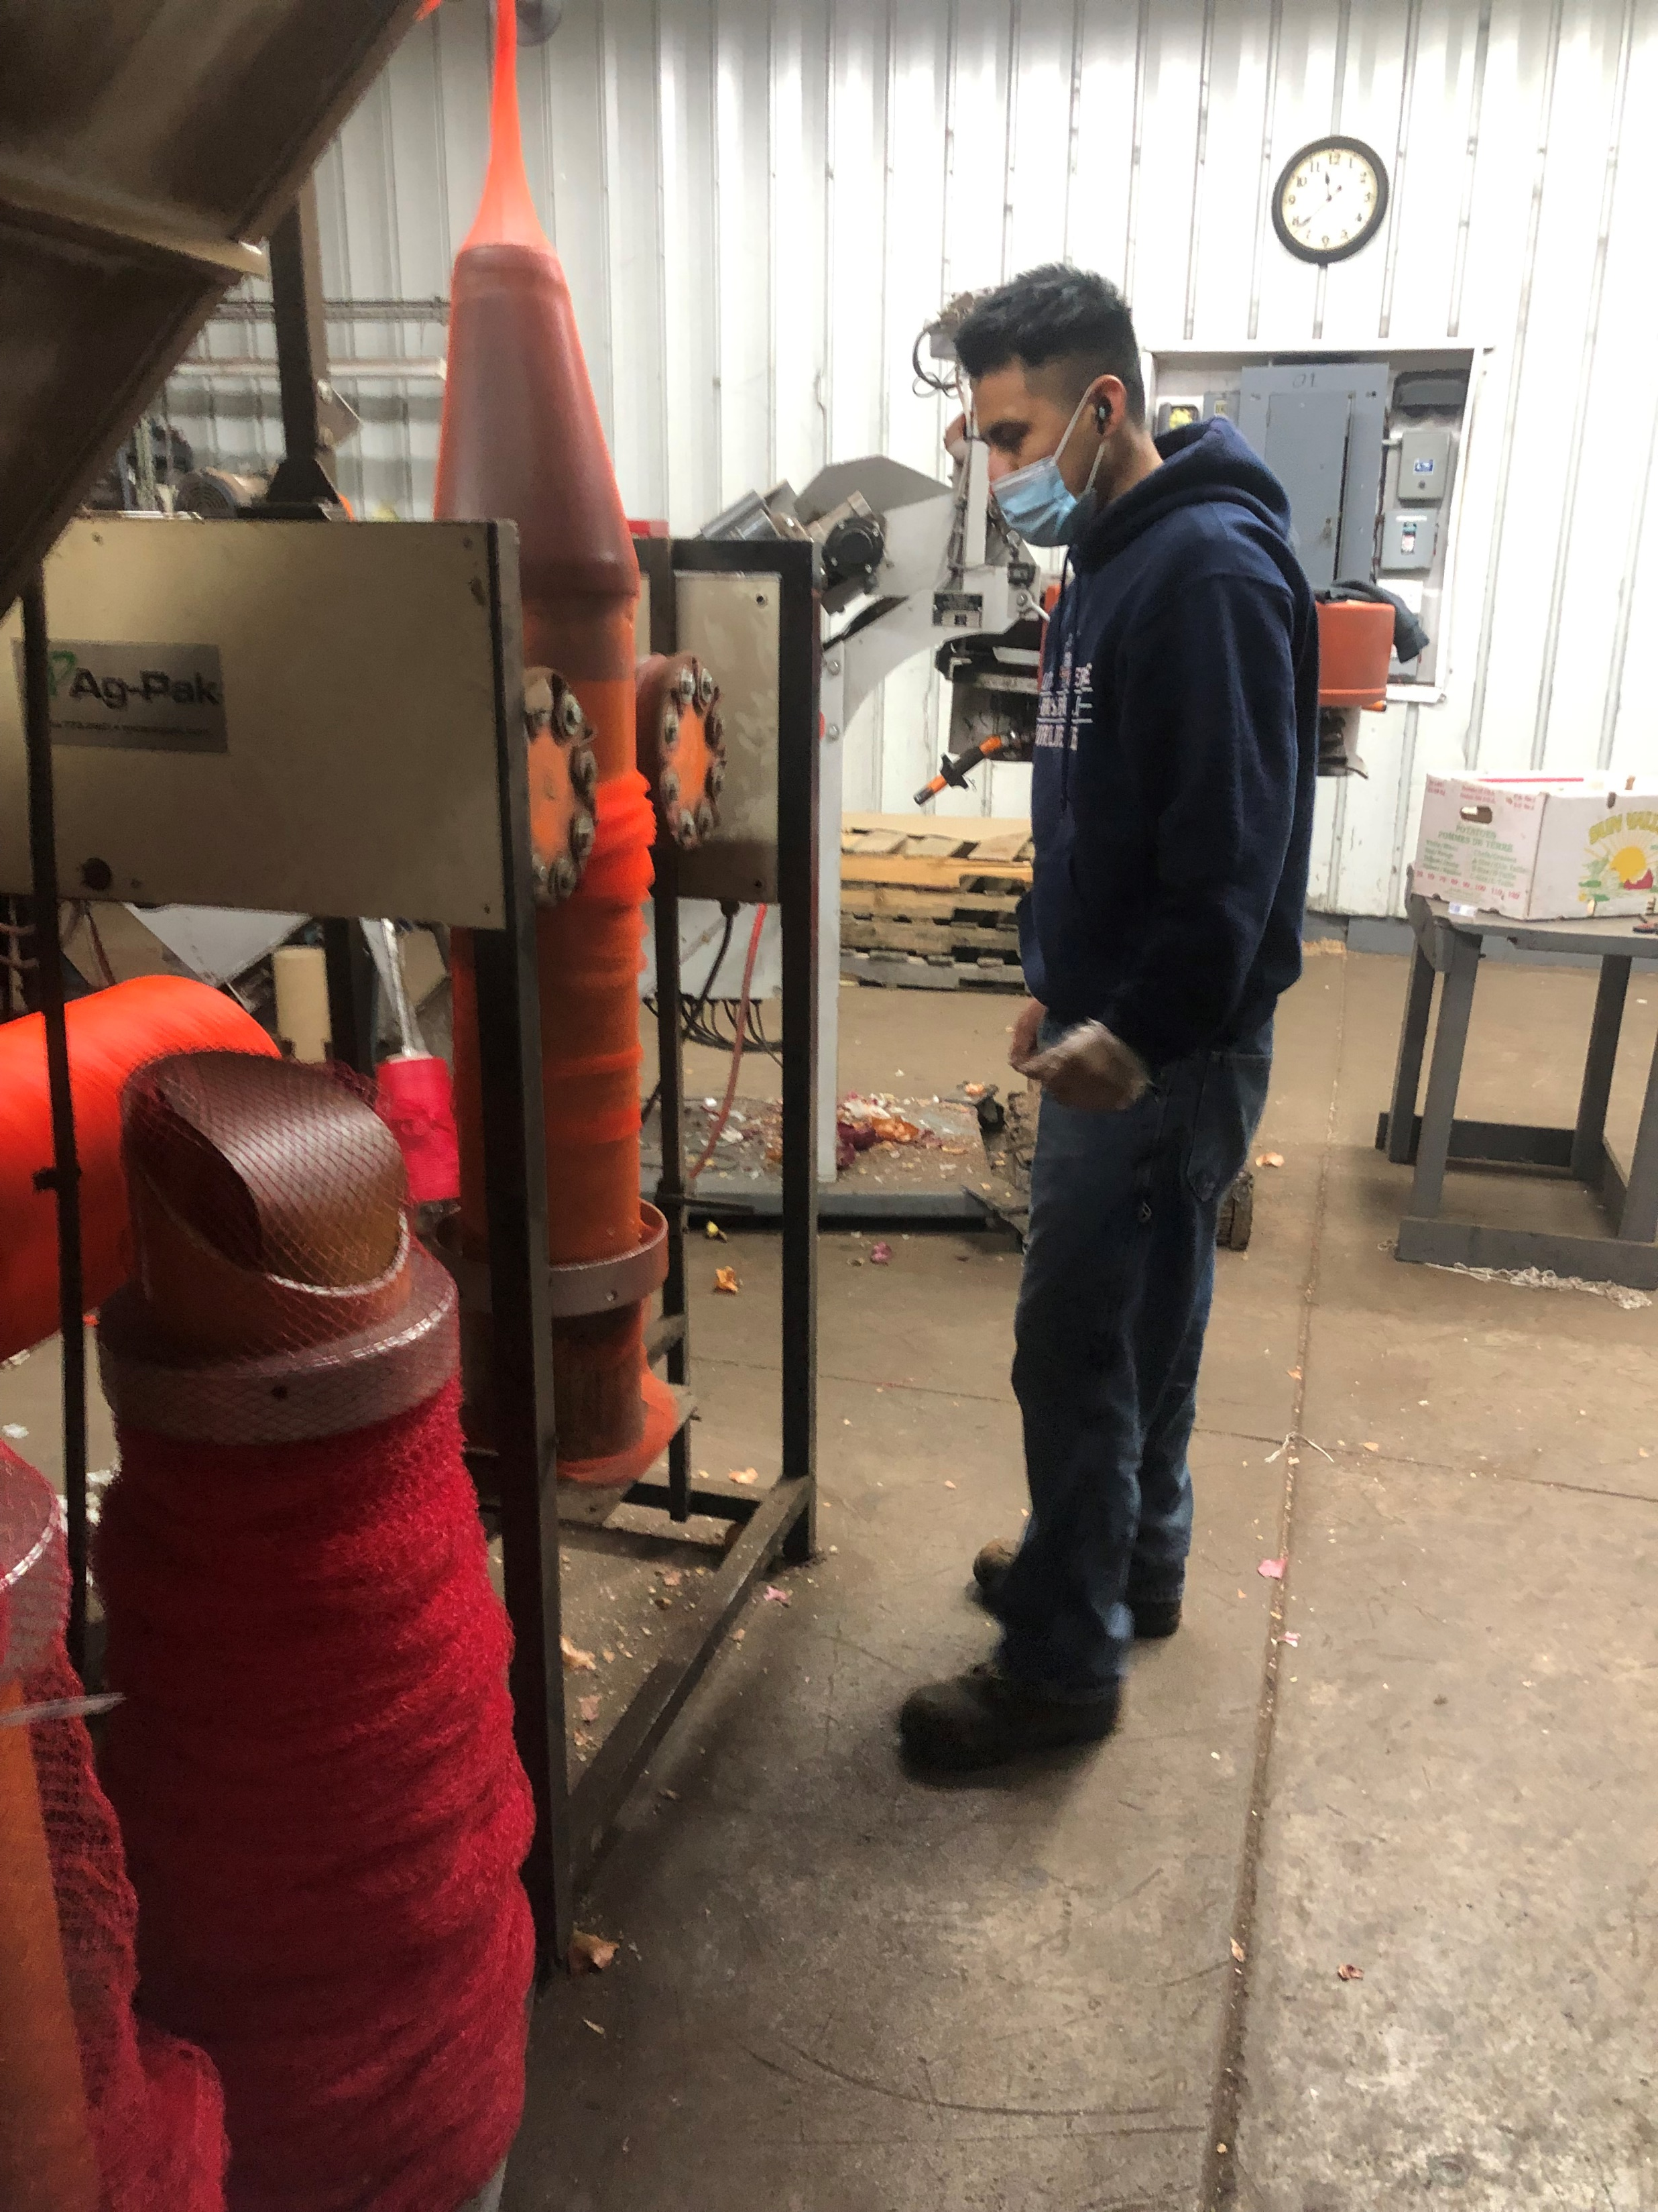

Slide 12

Product Packing
Triple G packages the Potatoes from October – April
Triple G also packages Onions all year around
We bring in out-of-state Onions to compliment the Onions we grow.

Slide 13
Availability of Product
New York State Yellow Onions
August - April
New York State Red Onions
    September – February
Out of State Yellow Onions (Texas, Arizona, New Mexico, California)
    May – July
Out of State Red Onions (Nevada, California, Arizona)
March - August

Slide 14
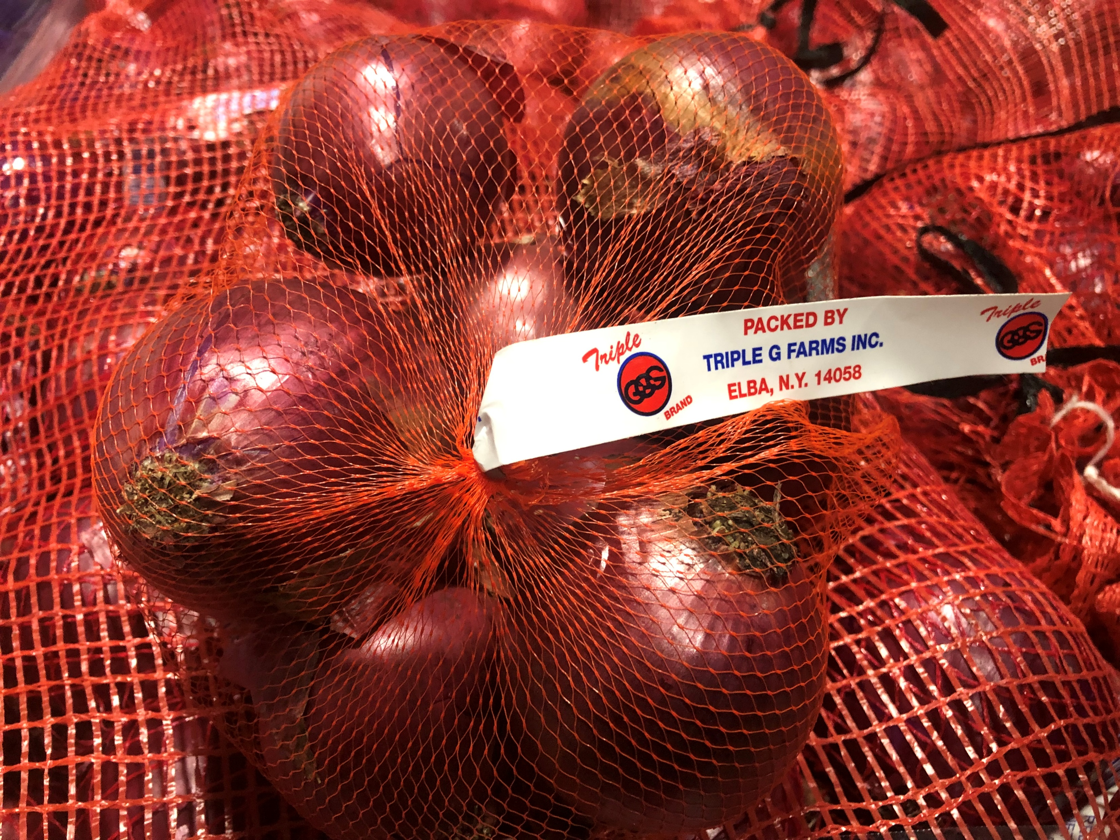
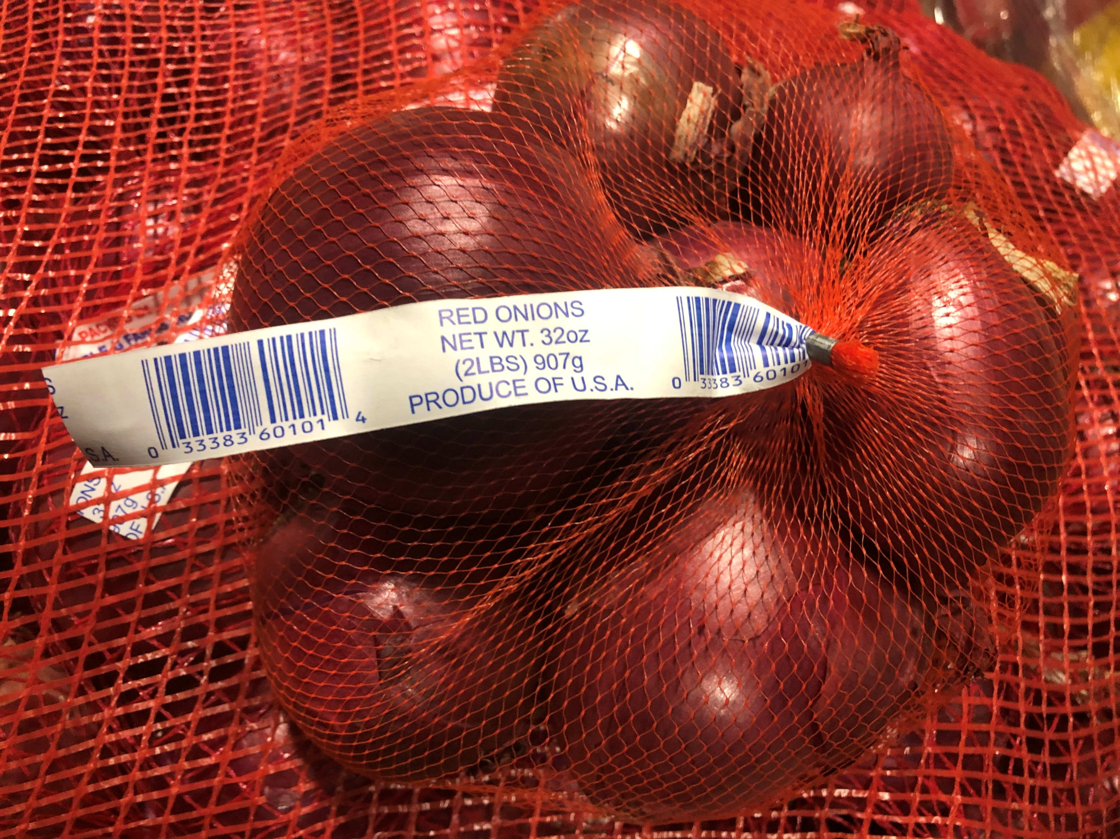
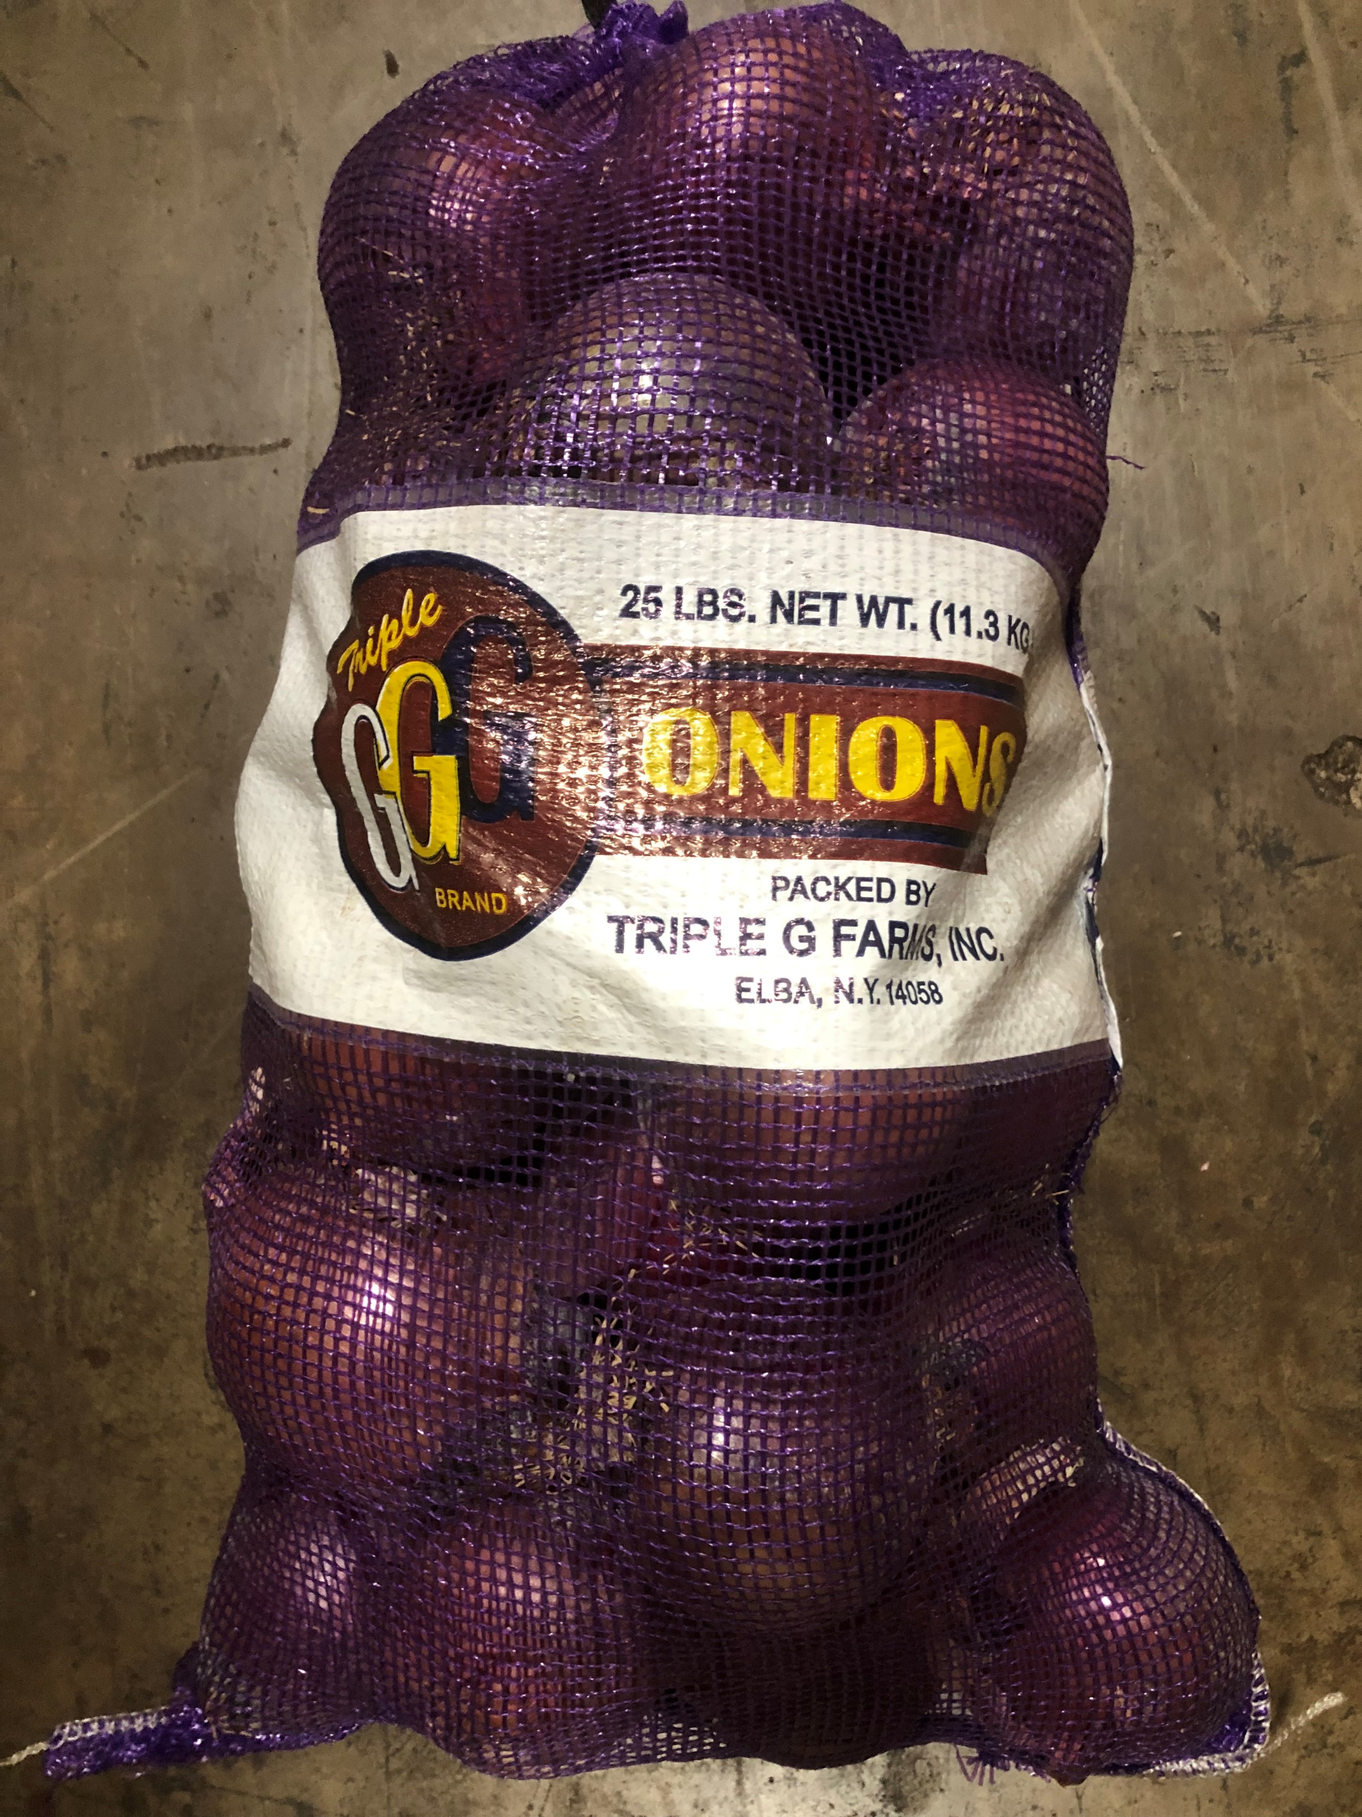
Example of Products

Slide 15
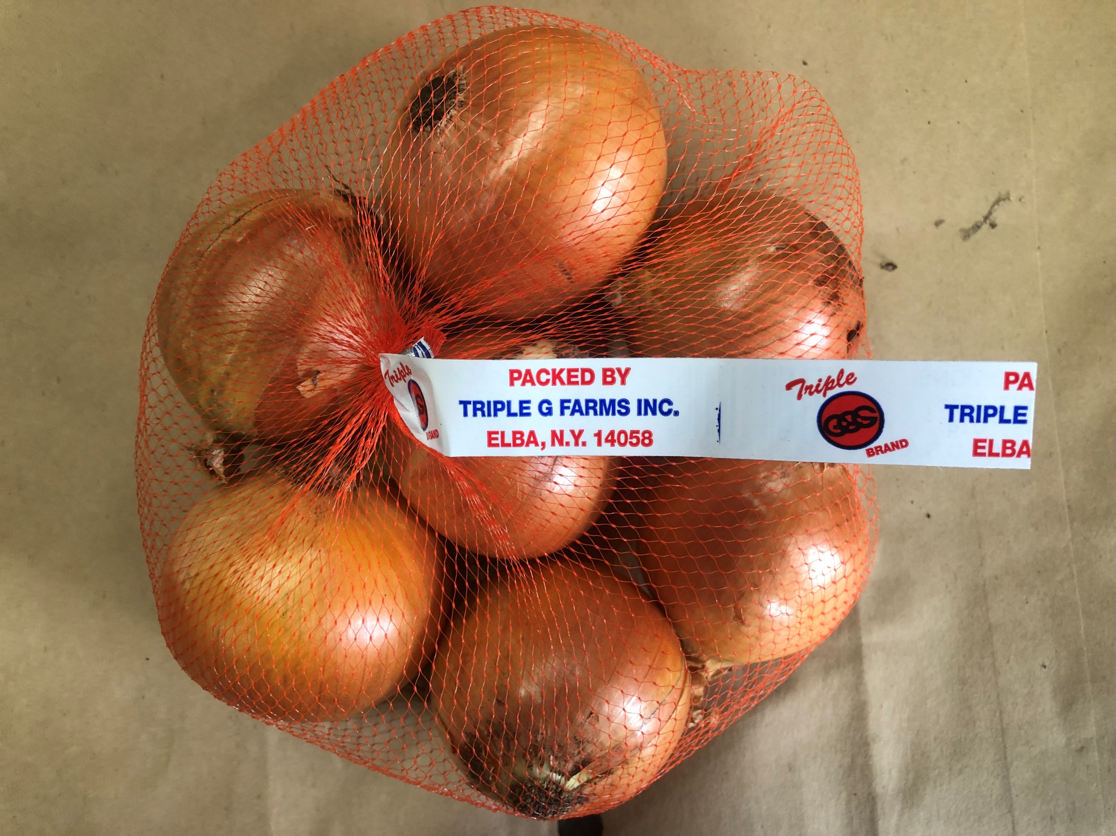
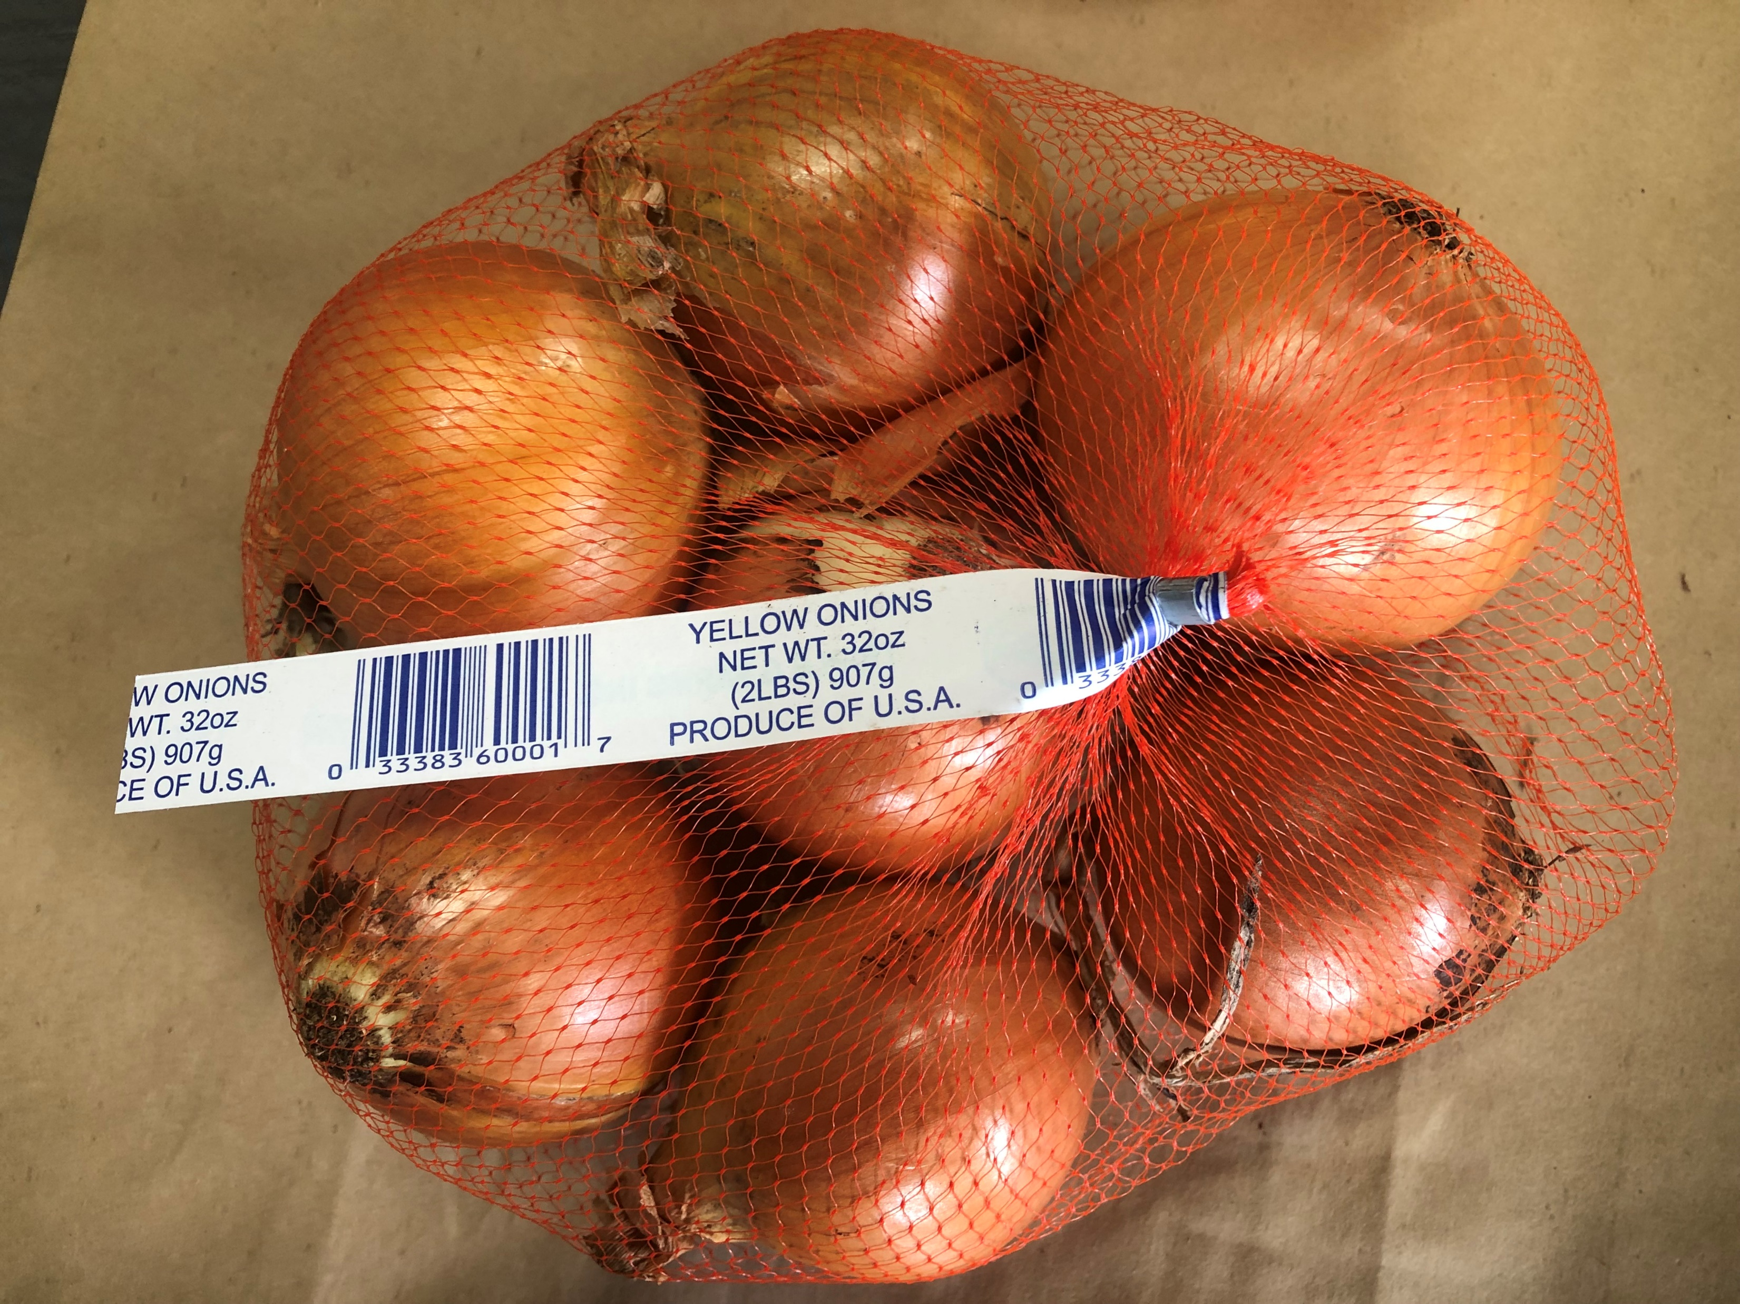
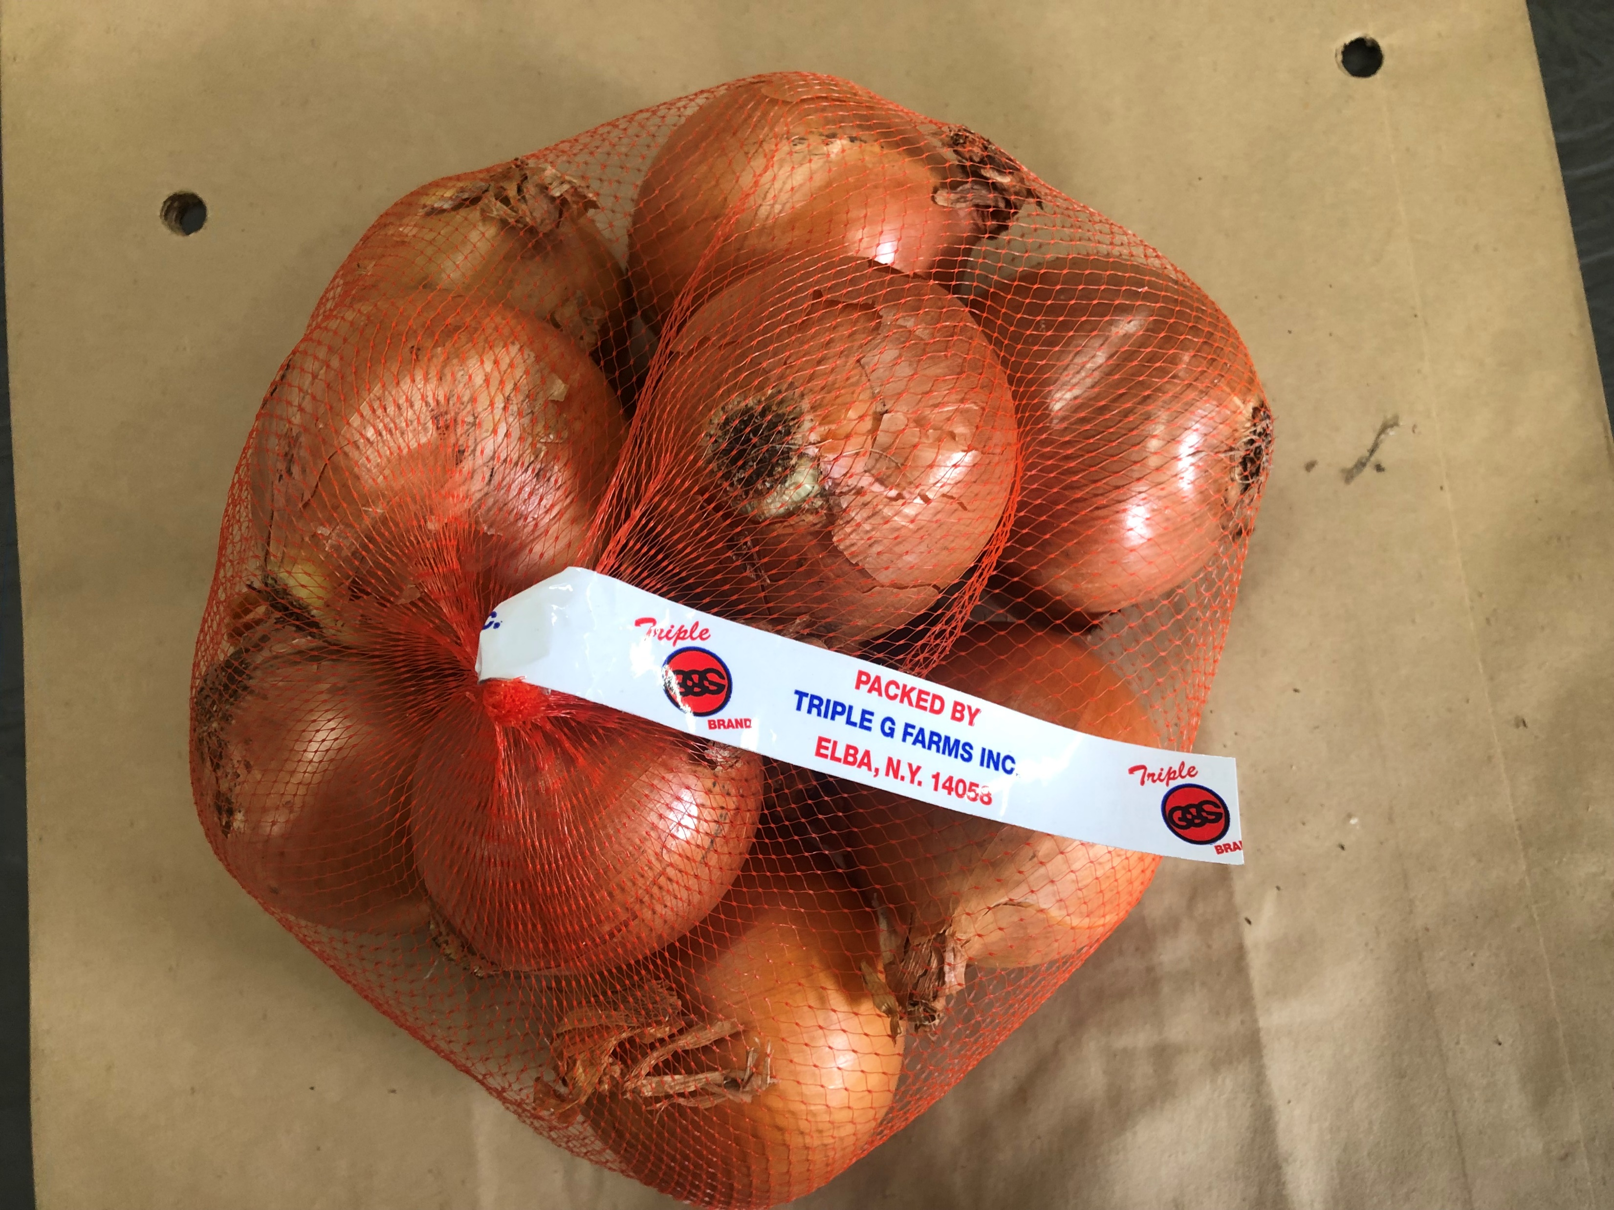
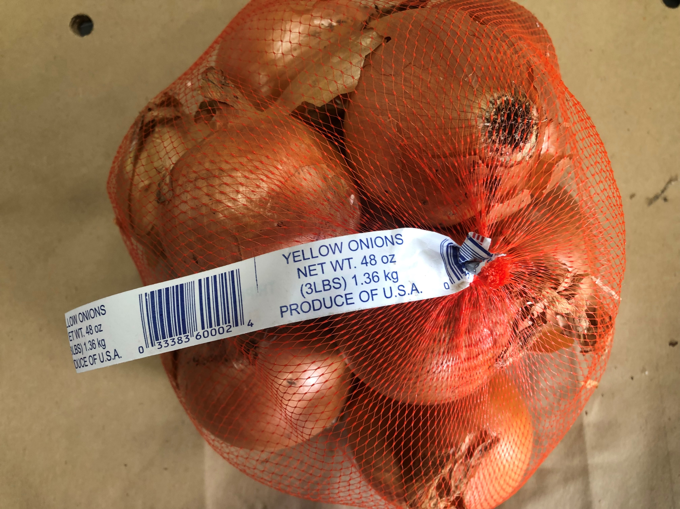

Slide 16
Promotional Capabilities
New York State Yellow Onions
September – March
2lbs, 3lbs & 5lbs packages available
New York State Red Onions
October – January
2lbs & 25lbs (Jumbo Red) packages available
Out of State Promotional Yellow & Red Onions depending on Market Pricing.

Slide 17
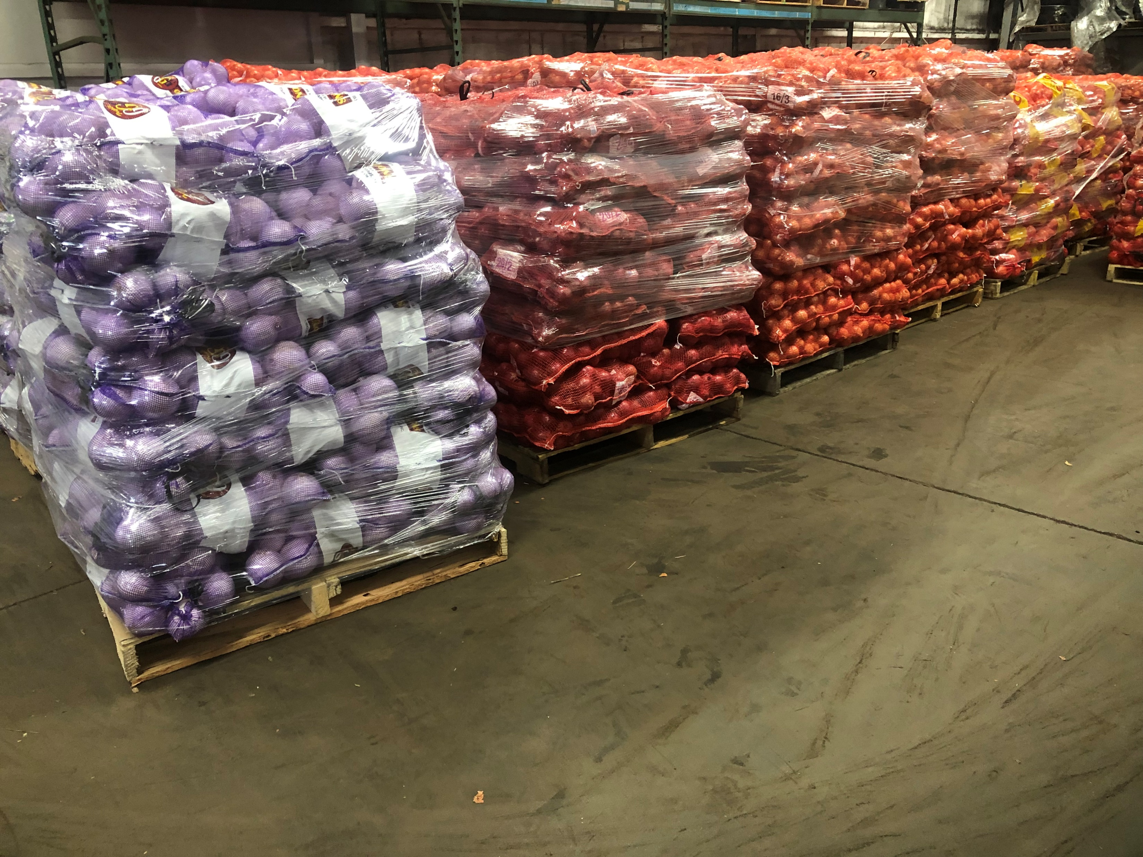

Slide 18

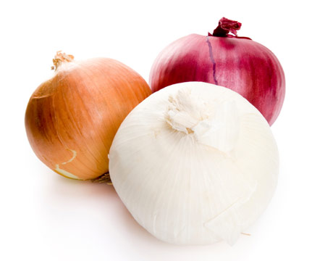
Onion Package Sizes
2 and 3 lbs
5 and 10 lbs
25 and 50 lbs

Slide 19
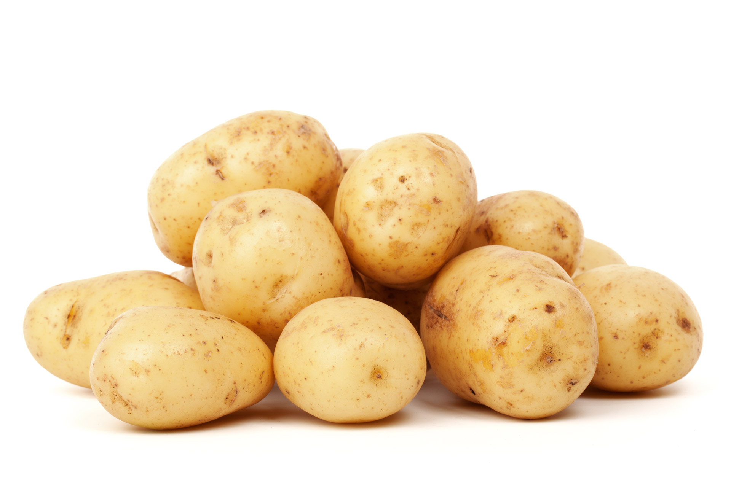
Potato Package Sizes
5 and 10 lbs
50 lbs

Slide 20
Photo Gallery
From Spring to Fall

Slide 21


Slide 22
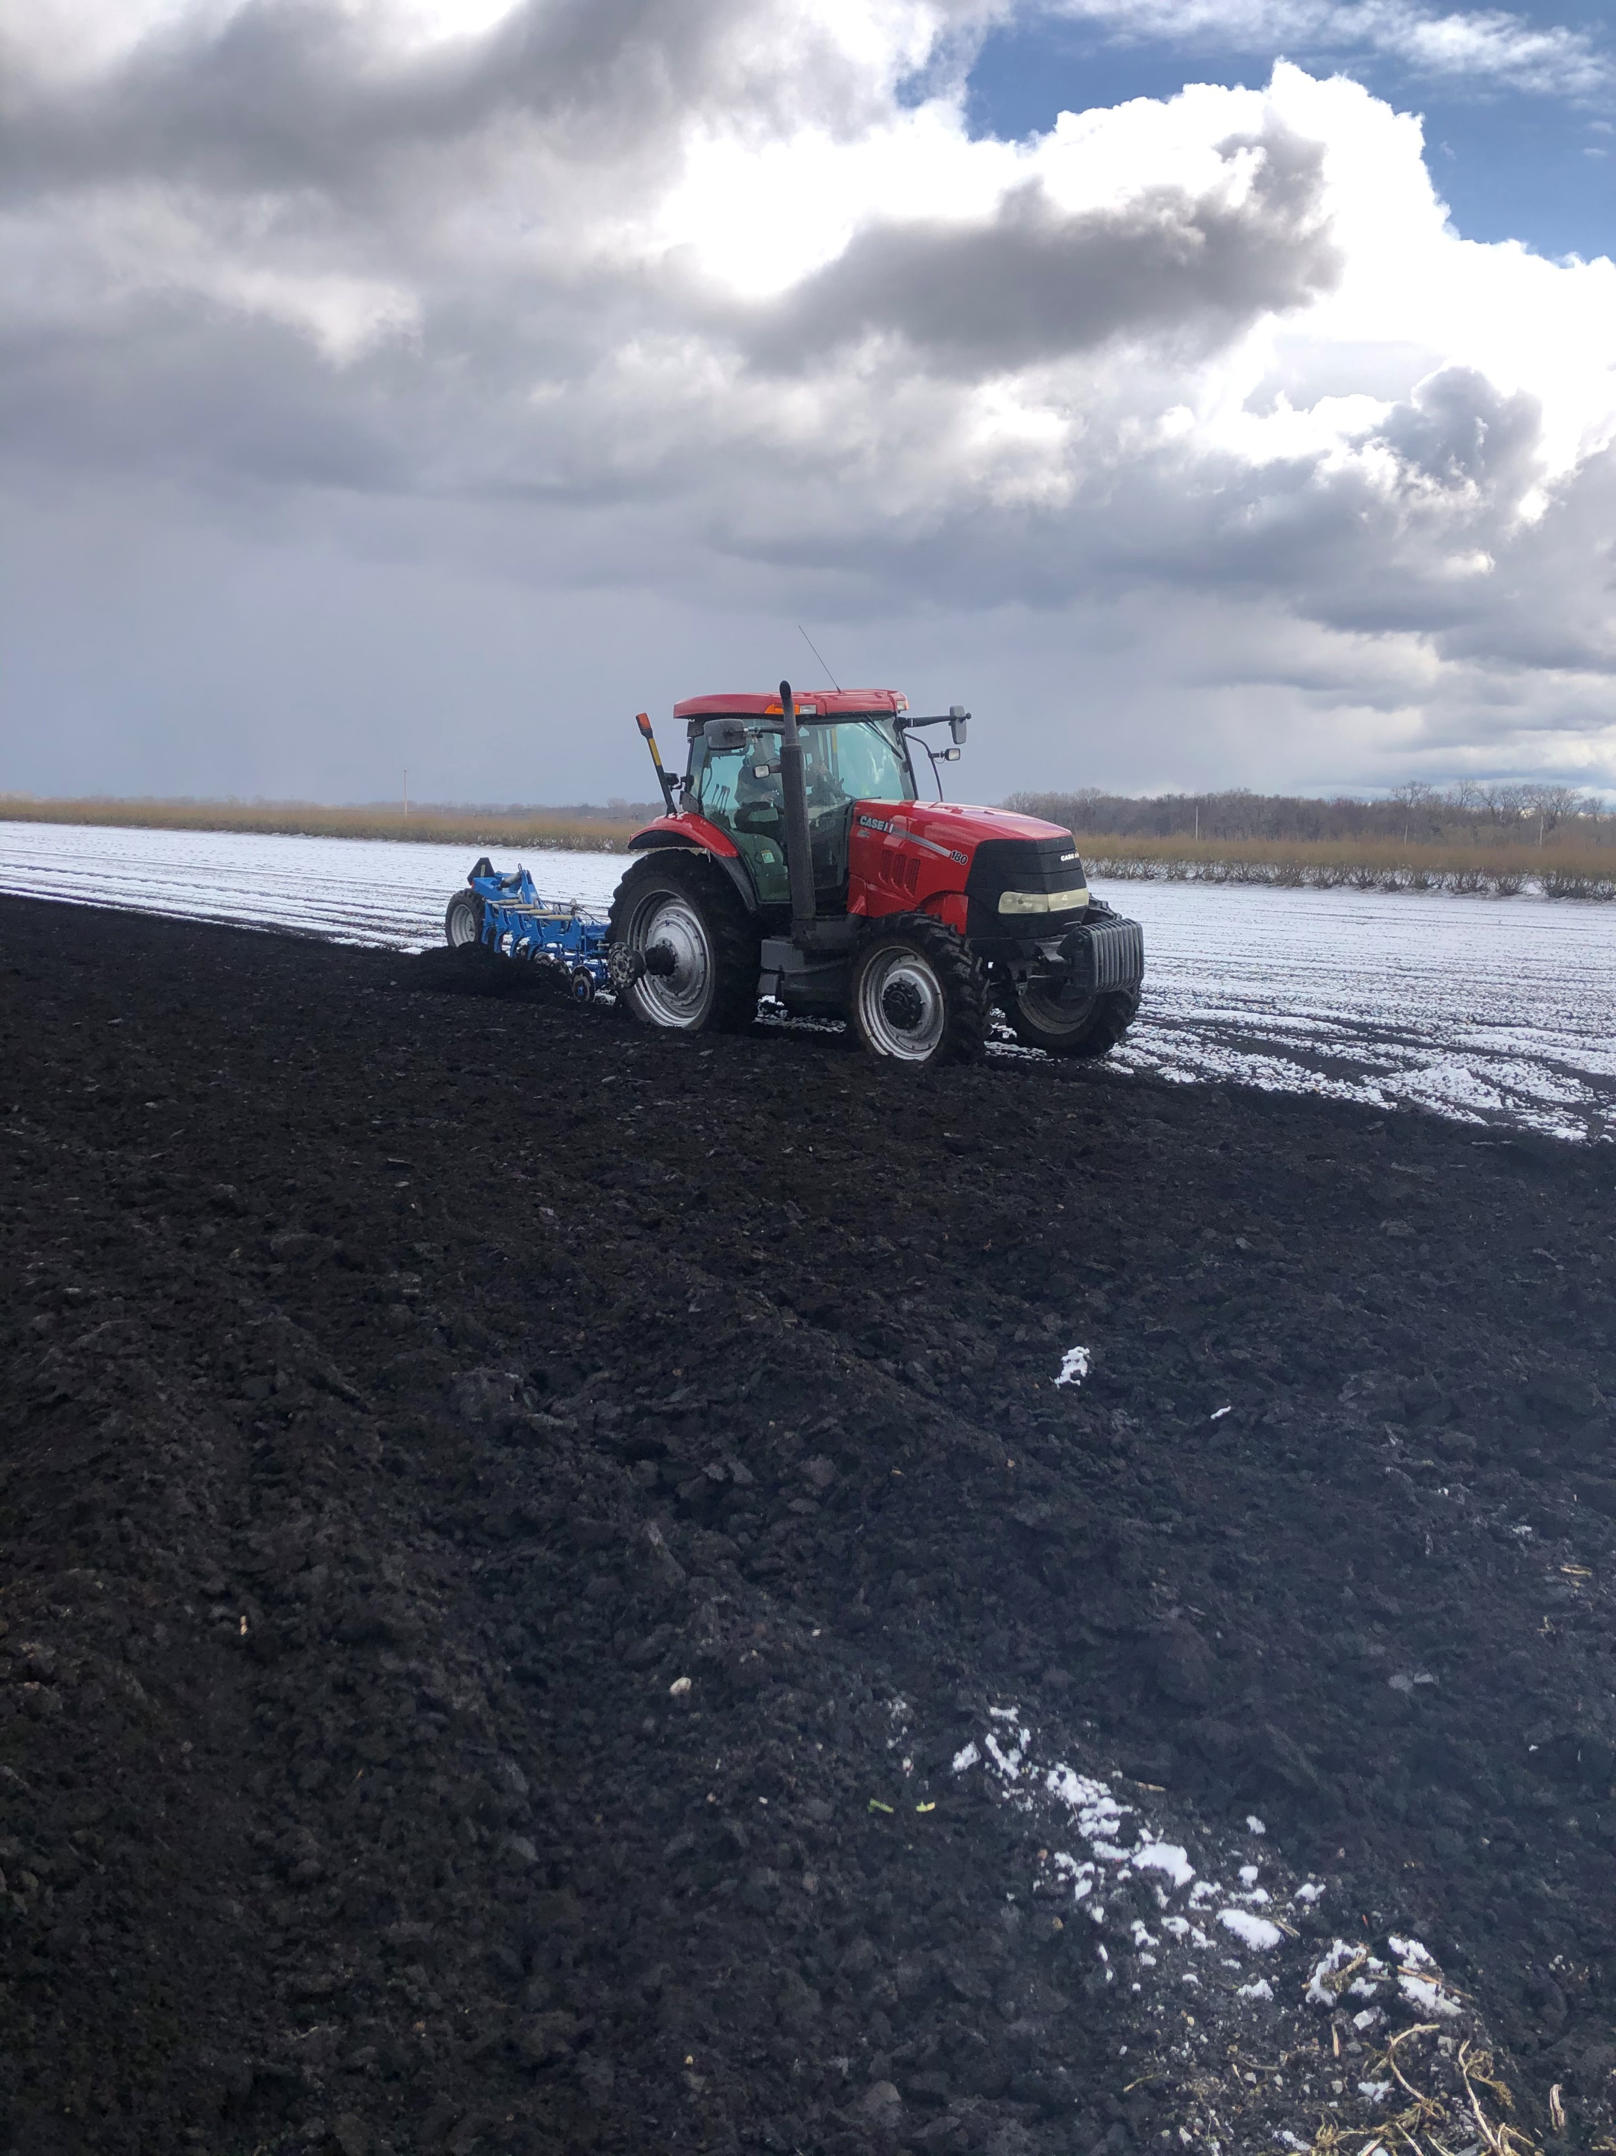

Slide 23
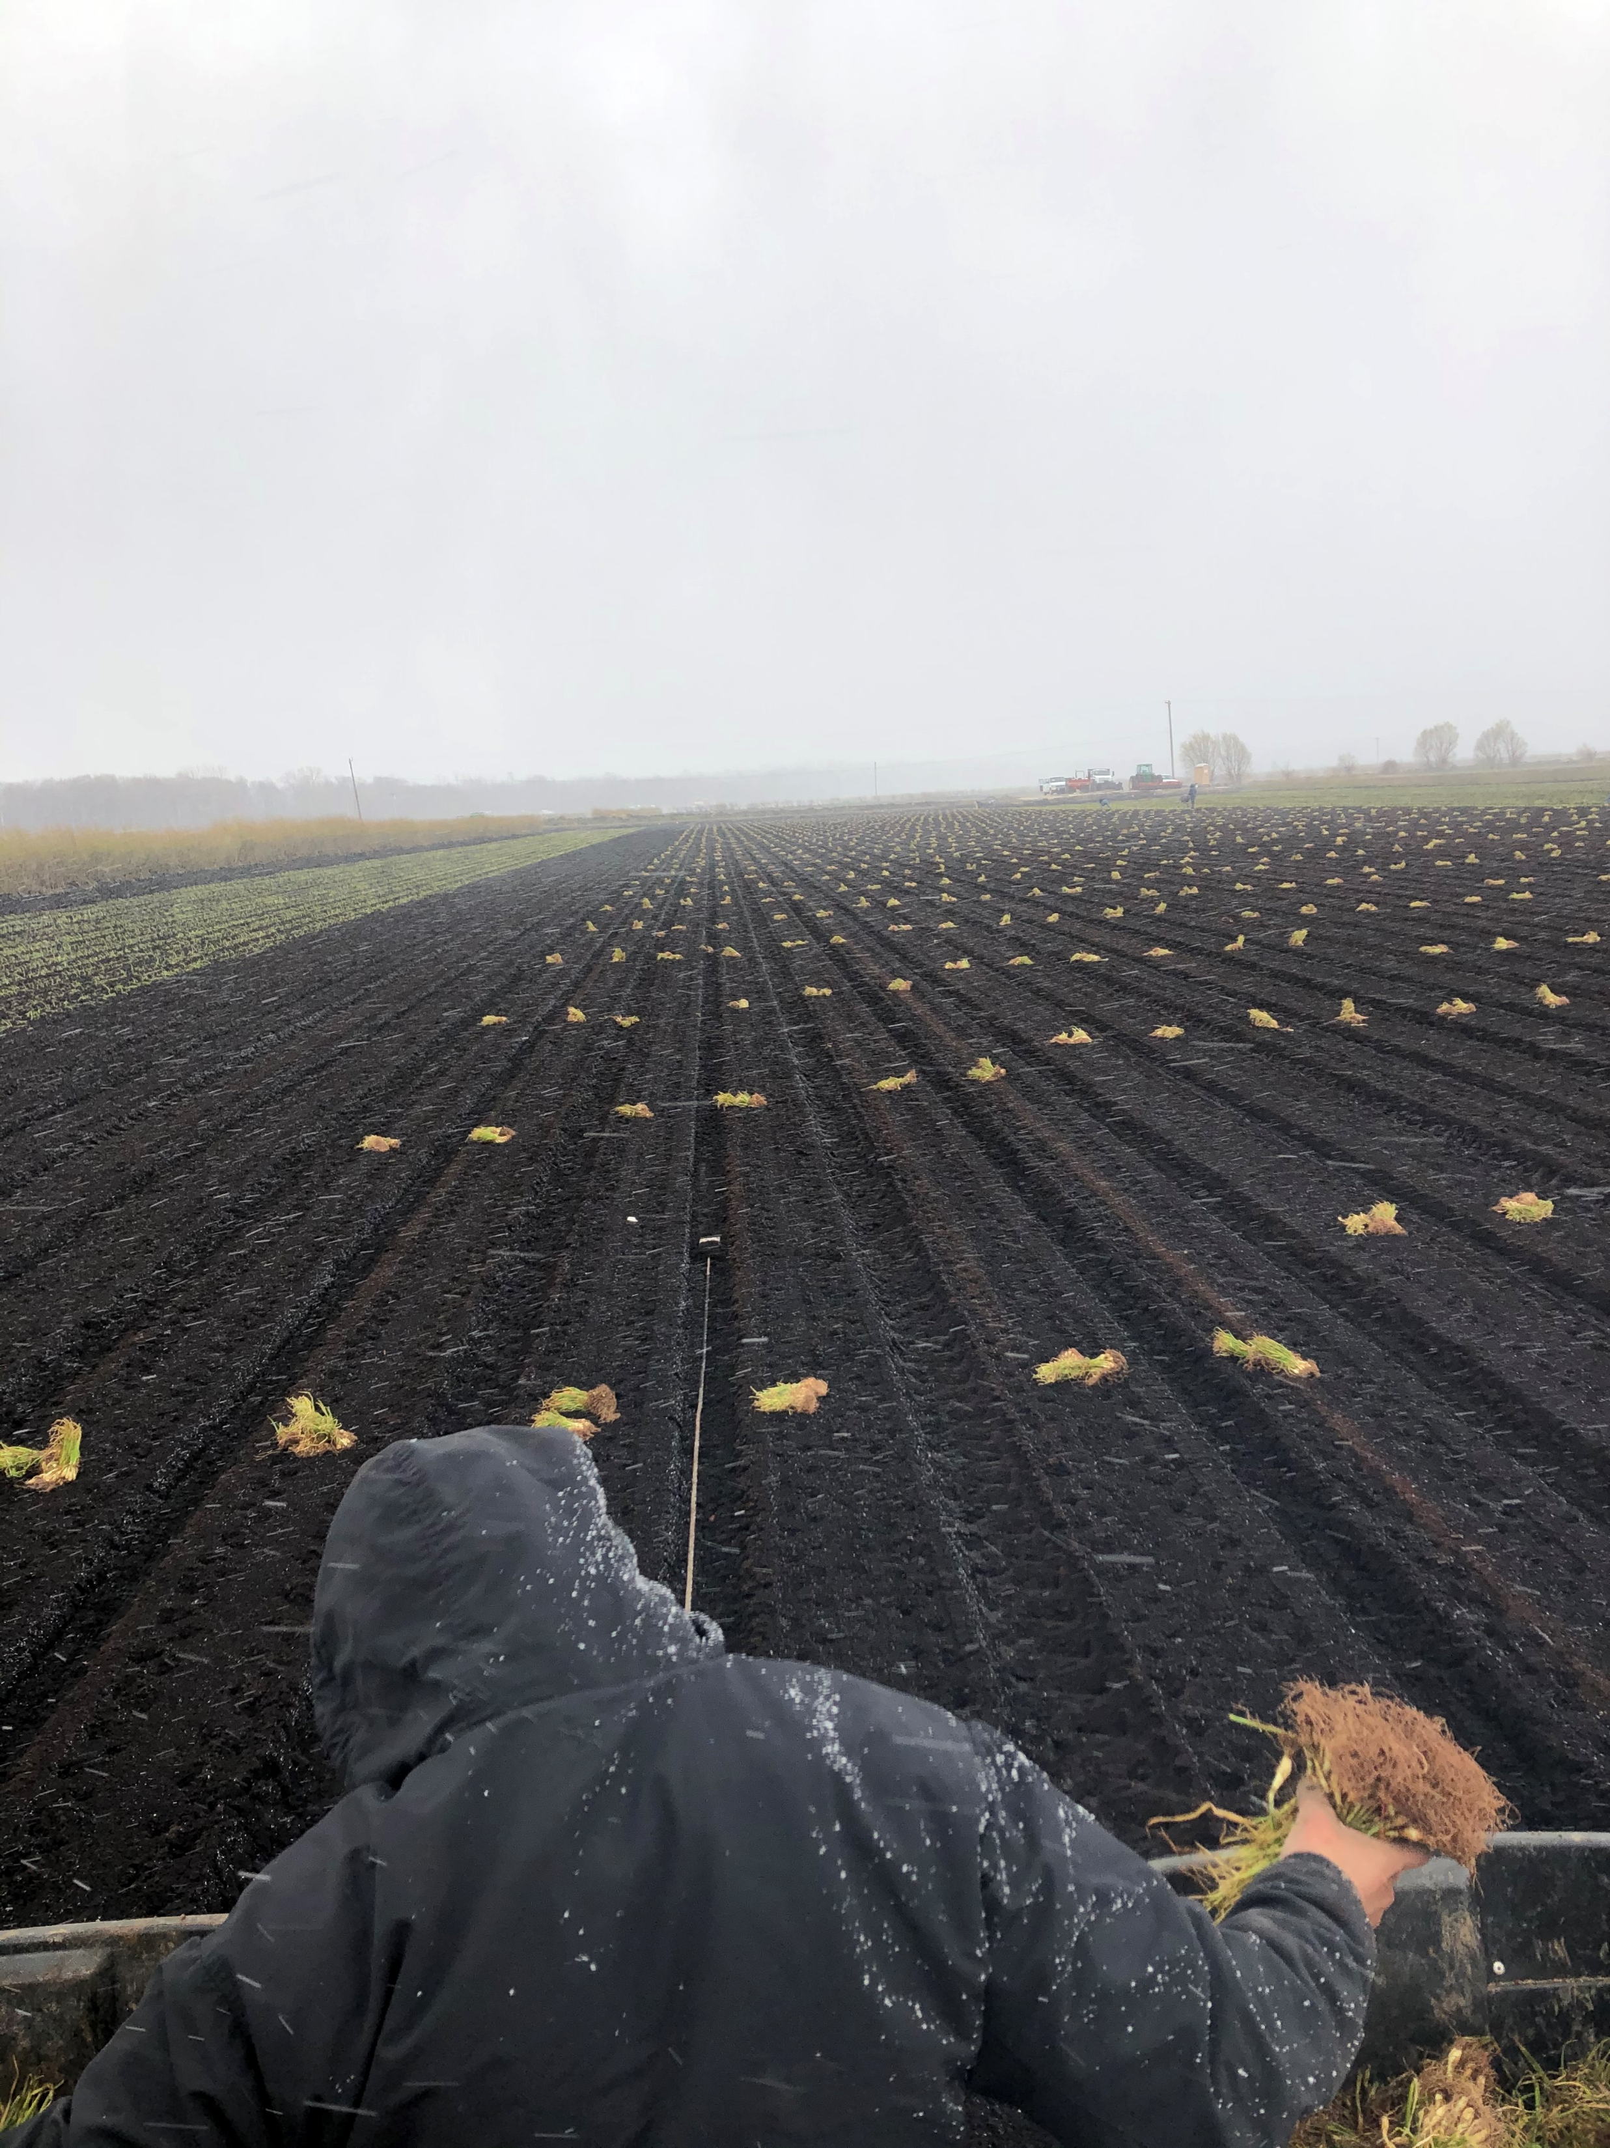

Slide 24
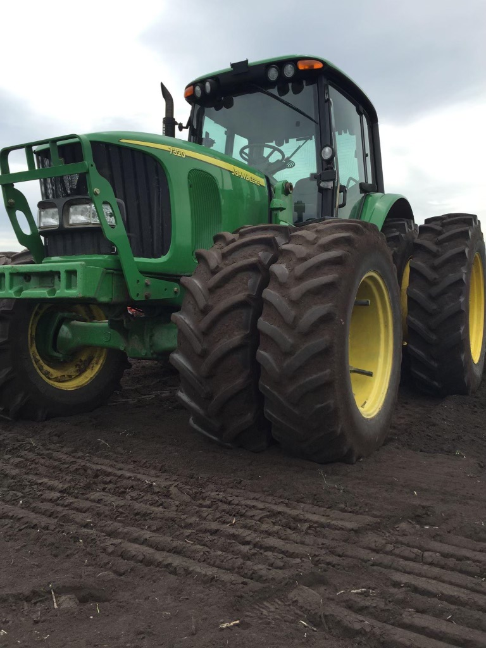

Slide 25
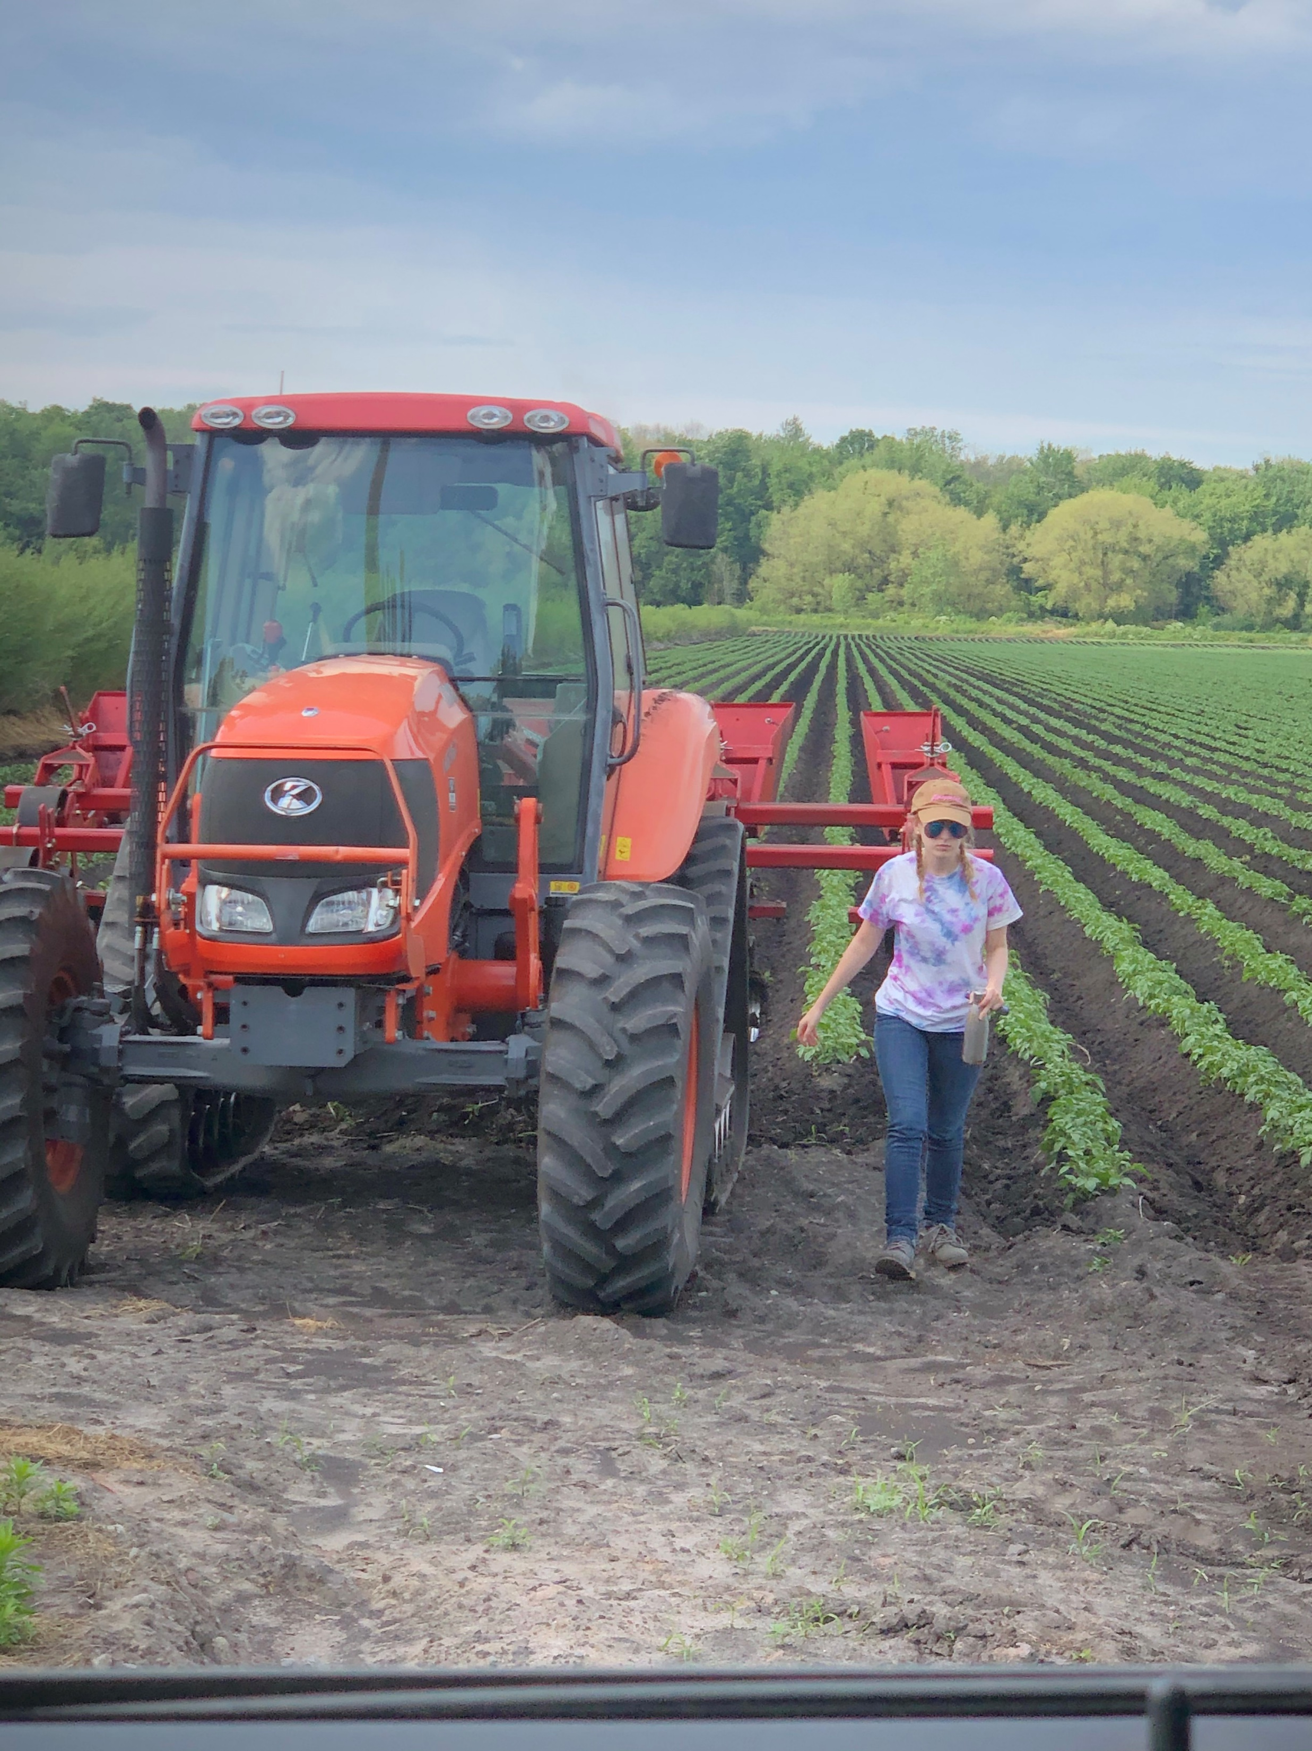

Slide 26
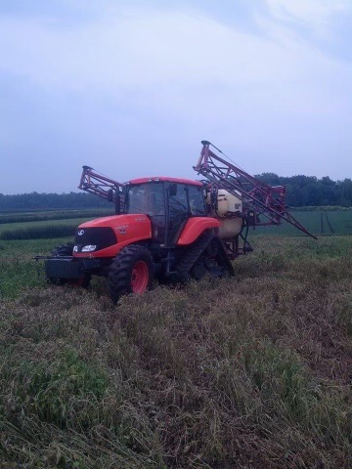

Slide 27
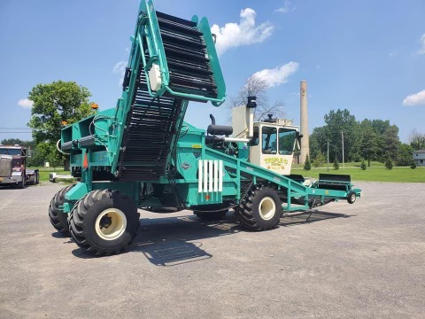

Slide 28
